Slide 1


PROJECT ON ANALYTICS
PRESENTED BY
ANISHA DHAR

Slide 2

PROBLEM STATEMENT
Nitin works as a Graphic Designer in a new company. He earns Rs 15,000/- per month. He is planning to buy a scooter for his daily commute to the office.
For the last couple of months, Nitin is not able to save at all for his scooter. His friend Ayush told him that he needed to figure out where most of the money goes and cut down that expense.
Help Nitin increase his savings by removing some unnecessary expenses.

Slide 3

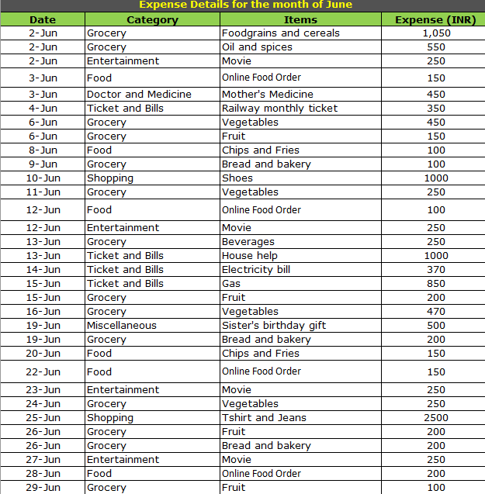
PROJECT 1 - PART 1
This is Nitin's expense sheet for the month of June.

Slide 4
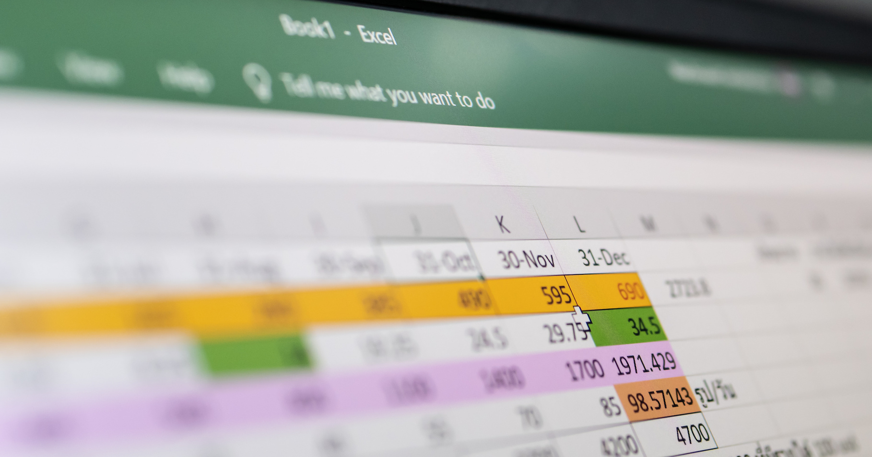
TASK 1

Slide 5
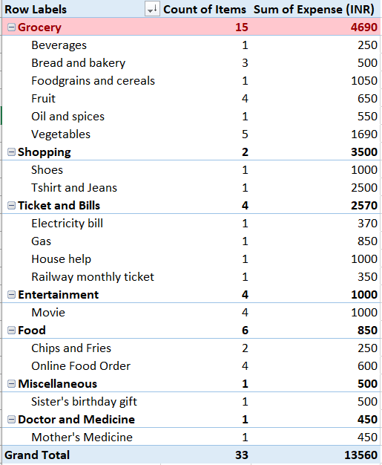
The category with the highest expense amount is Grocery which is highlighted by a red mark.

Slide 6
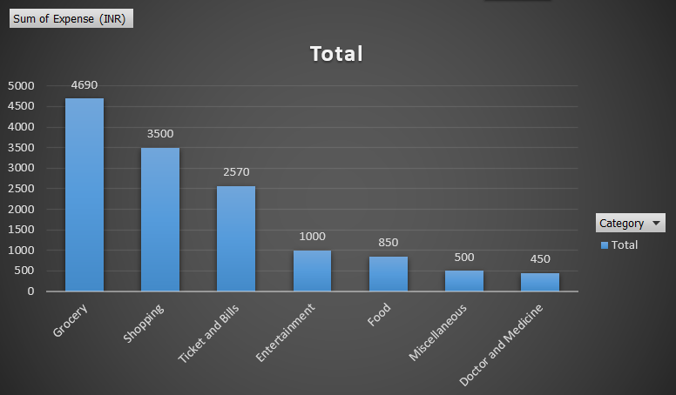
Visually represented the amount spent against each category.

Slide 7
TASK 2

Slide 8
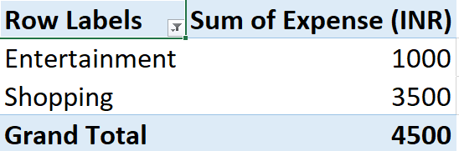


The total expense amount against entertainment and shopping is shown in a table.

Slide 9
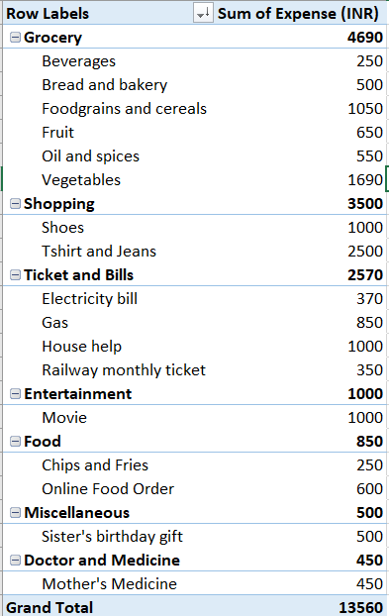
The money spent on different items of each category

Slide 10
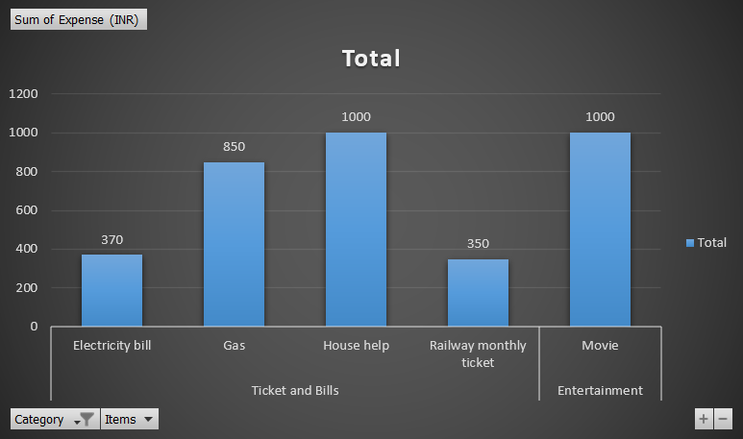
Visually represented the amount spent on different items of Entertainment and Tickets and bills category

Slide 11
TASK 3

Slide 12
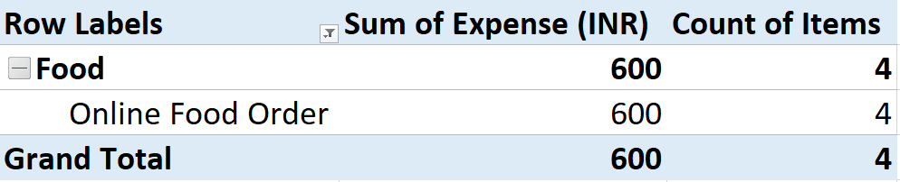
Number of times Nitin has ordered food online and the amount spent for it

Slide 13
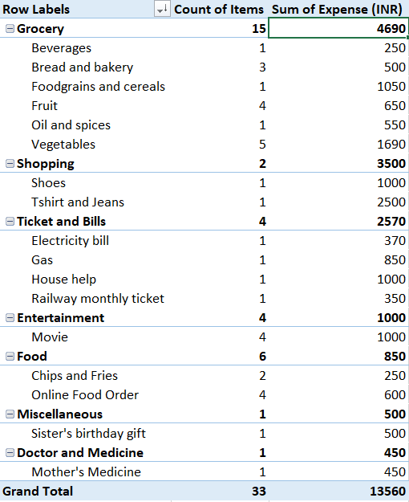
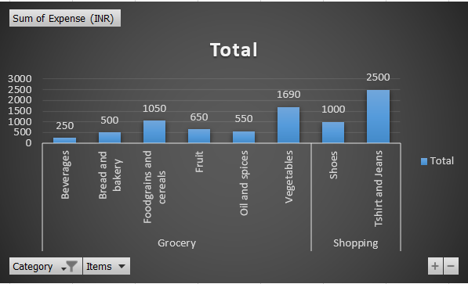
Filtering the data to display the data for Grocery items and Shopping items.
Money spent on different items of each category

Slide 14
TASK 4

Slide 15
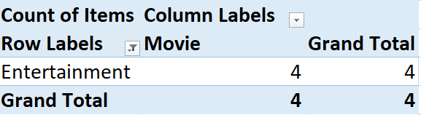
Number of times Nitin has watched a movie.

Slide 16
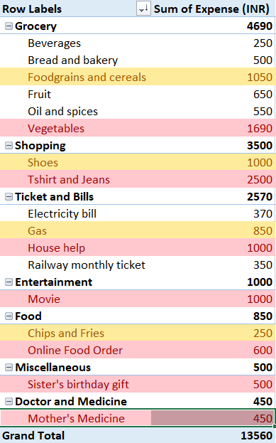
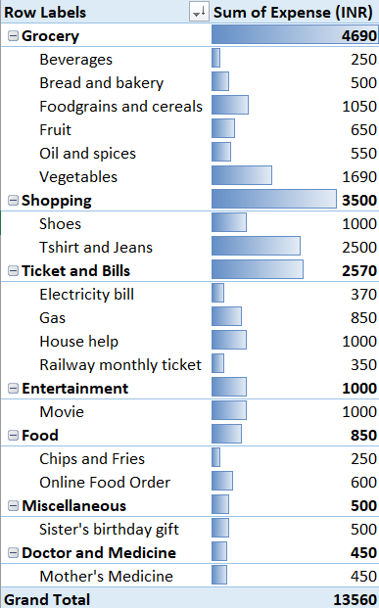
The highest and second highest expense amount has been highlighted as red and yellow respectively.
Represented the data with data bars(conditional formatting).

Slide 17
TASK 5

Slide 18
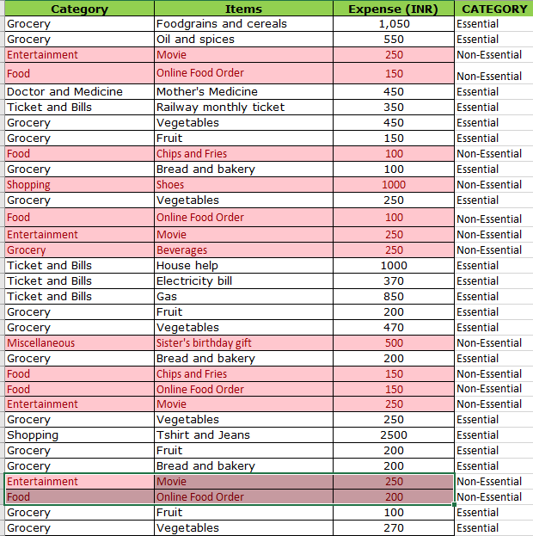
The less essential category that Nitin may remove to increase his savings has been highlighted by a red mark and also been categorized as non-essential.

Slide 19
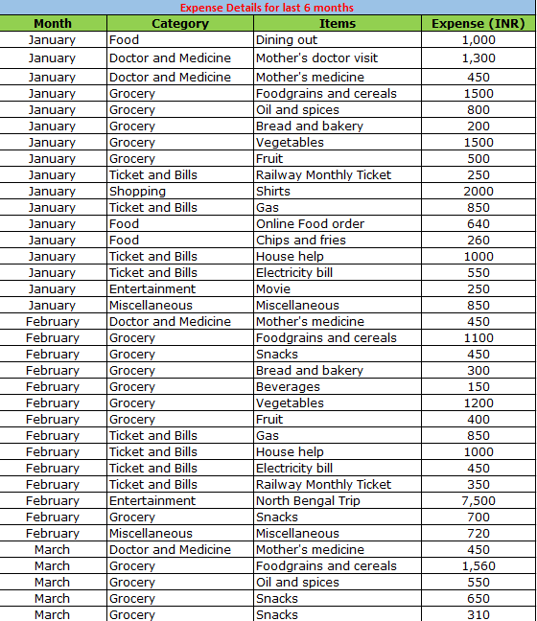
PROJECT 1 – PART 2
This is Nitin's expense sheet for the last 6 months.

Slide 20
TASK 1

Slide 21
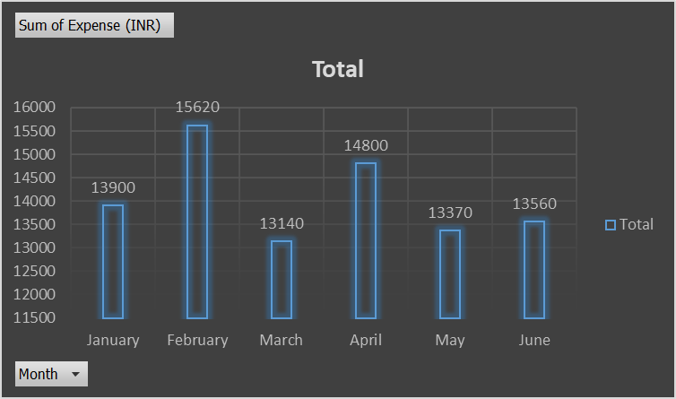
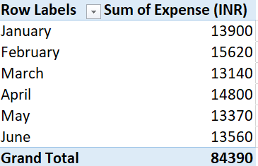
Month-wise trend of expenses
According to the bar graph, we can see Nitin has spent the most in the month of February.

Slide 22
TASK 2

Slide 23
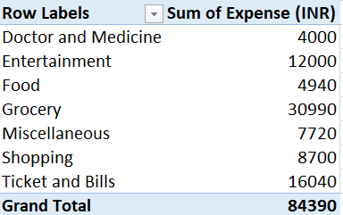
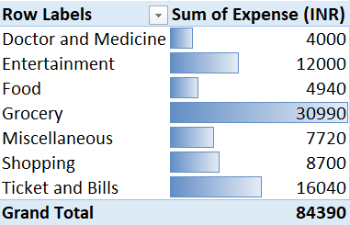
Category wise expenses has been showed in a pivot table.
Visually represented data bars to display categories with the highest and lowest expense amount.

Slide 24
TASK 3

Slide 25
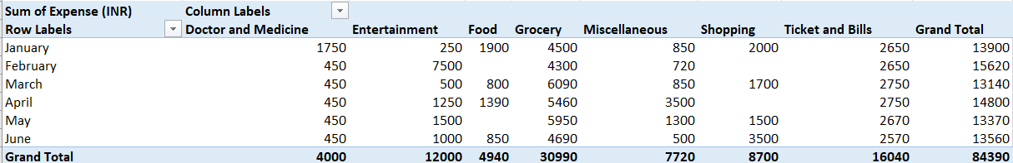
Month wise expense of each category shown in a pivot table.

Slide 26
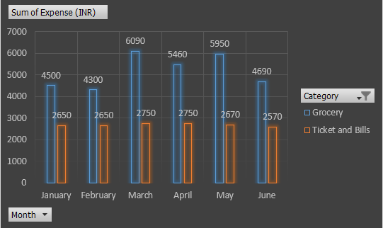
Grocery and Ticket And Bills are the top 2 categories with higher expenses.

Slide 27
TASK 4

Slide 28
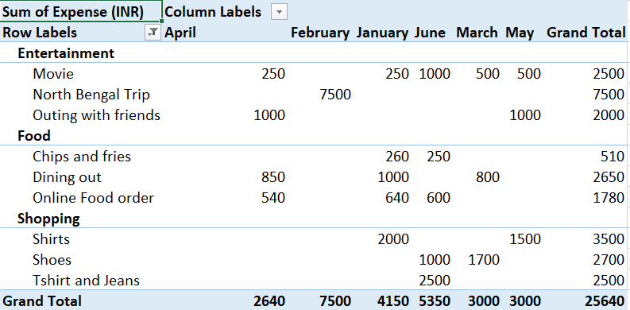
Money spent in each month against different items of Entertainment, Food and Shopping categories.

Slide 29
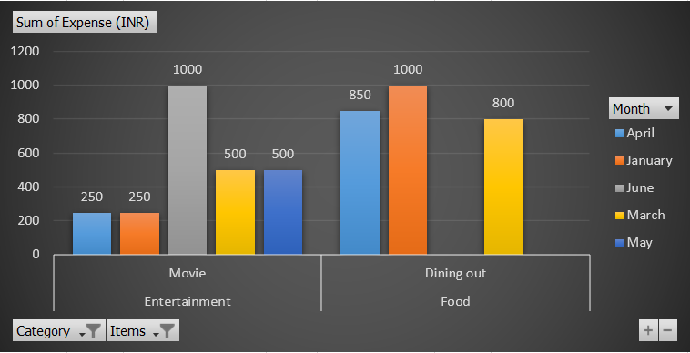
In the month of June Nitish has mostly spent on movie.
Whereas in the month of January Nitin has spent on Dining out.

Slide 30
RECOMMENDATIONS
1
2
3
FOOD
SHOPPING
ENTERTAINMENT
Frequent dining out and online food orders across six months, spending in this category averages ₹700-₹1000 per month. Reducing online food orders and snacks could save a lot. Preparing meals at home can significantly lower costs.
Shopping spiked over six months, spending in this category averages ₹1000-₹2000 per month. Limiting non-essential shopping for a few months could save. Delaying purchases until seasonal sales could reduce expenses by 20-30%.
Movie outings and trips are frequent. Cutting back on outings, reducing movies, or opting for cheaper entertainment options could save. Allocate a fixed amount for entertainment to avoid overspending.

Slide 31
THANK YOU!!

